Slide 1
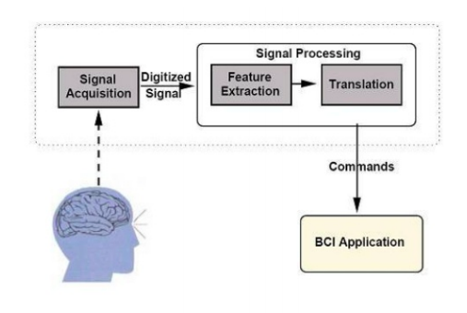
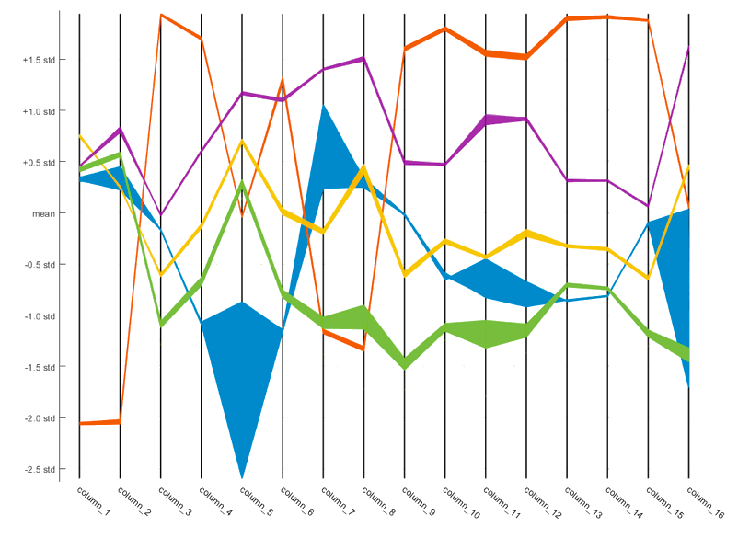
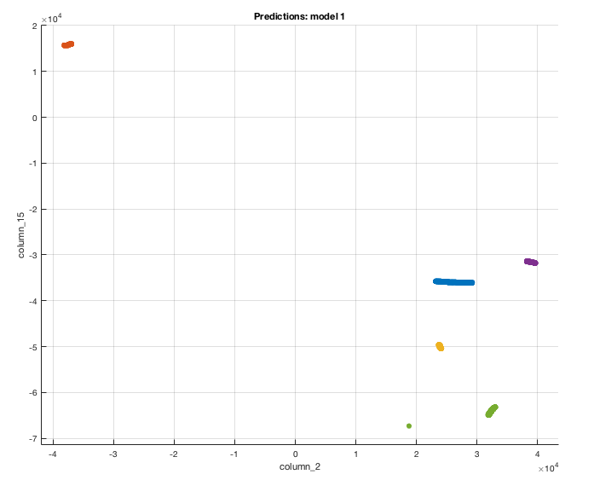
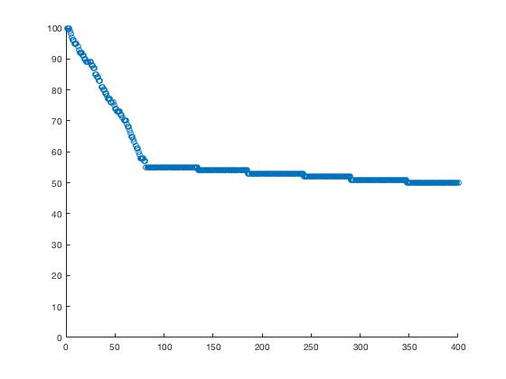
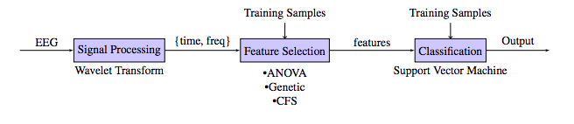
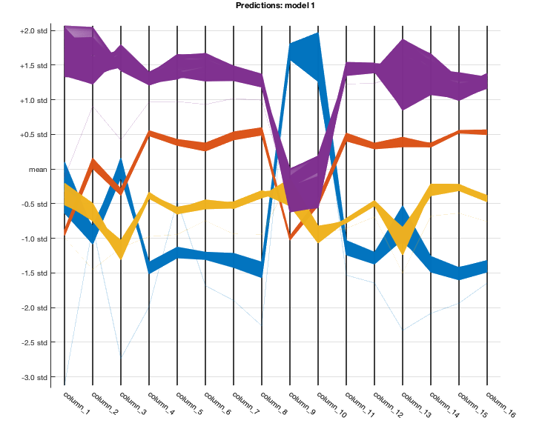

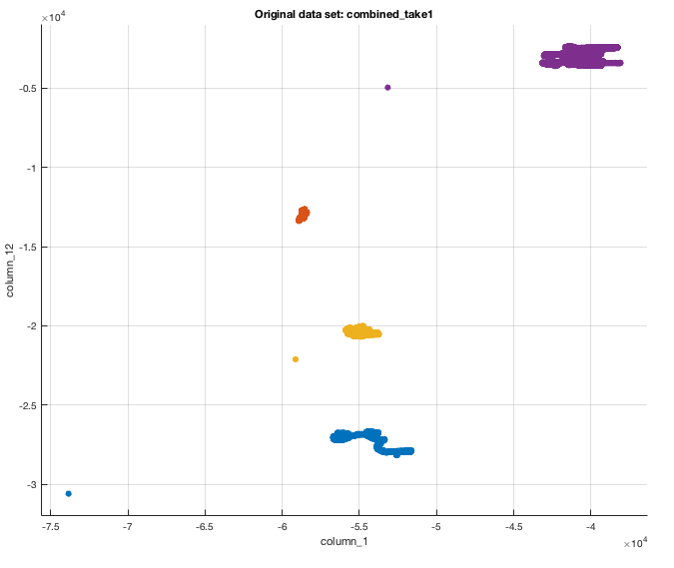
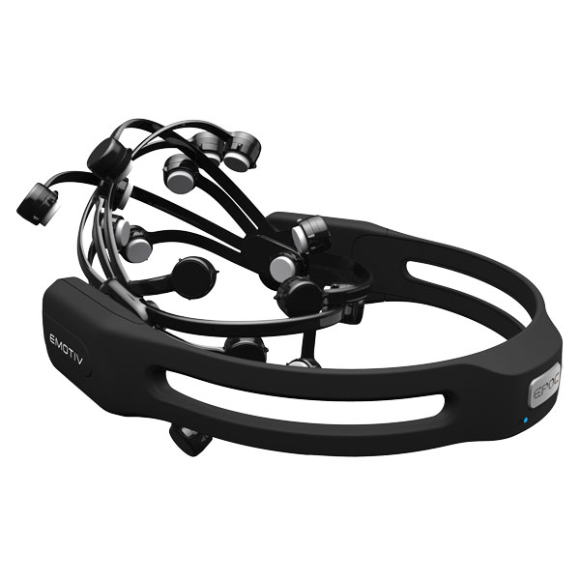
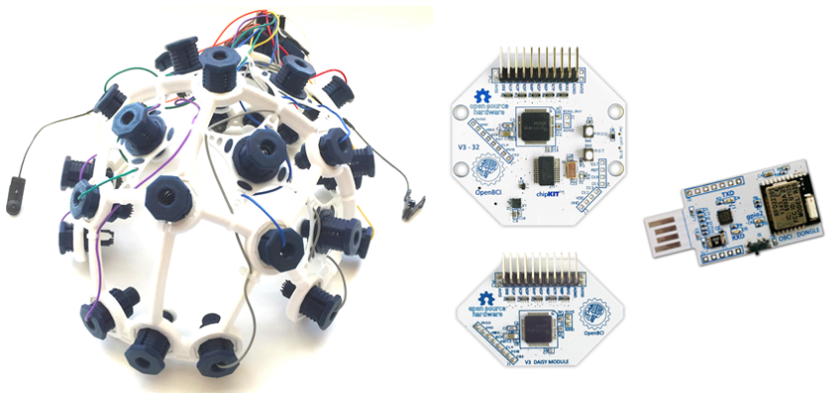

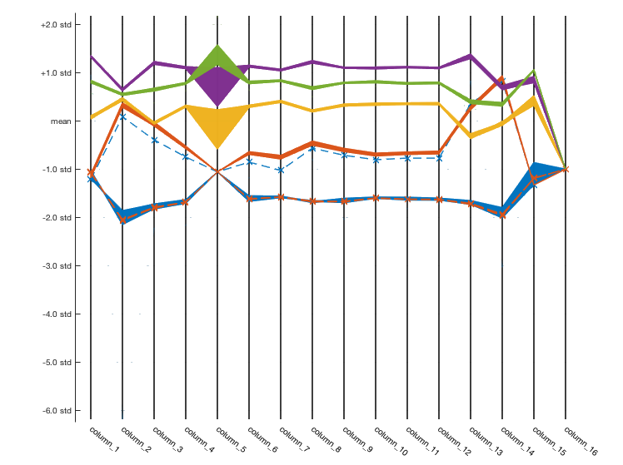
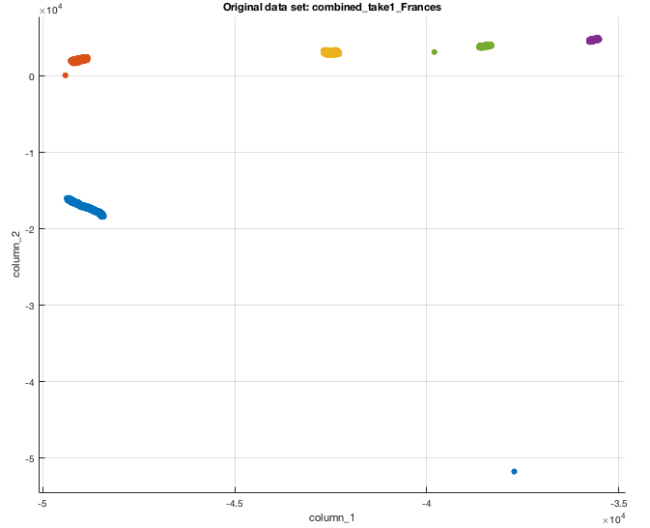
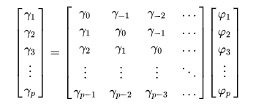
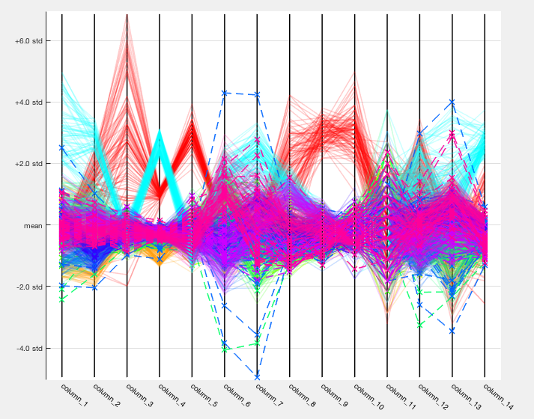

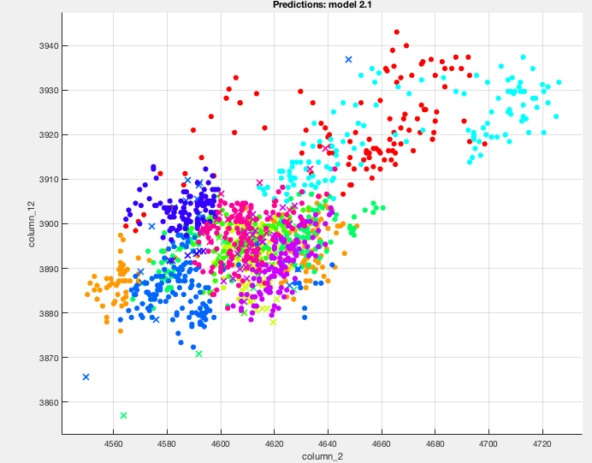


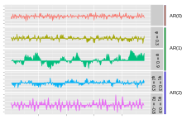
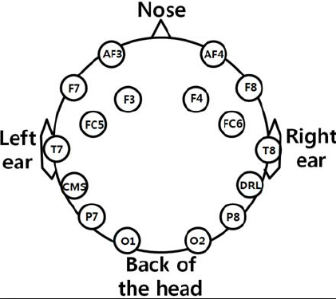
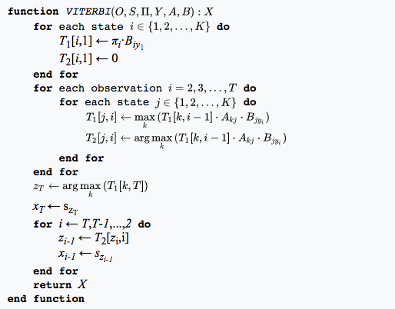
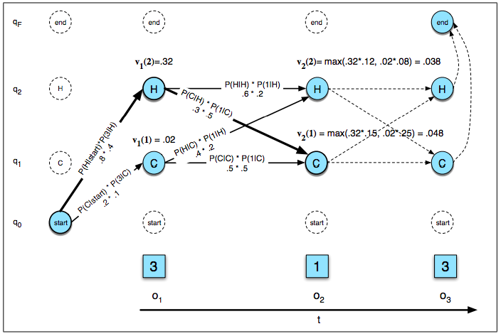

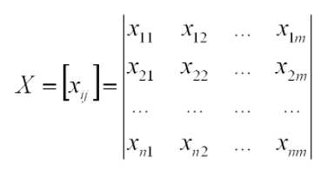
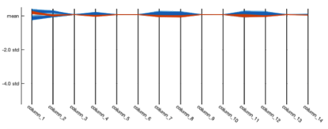
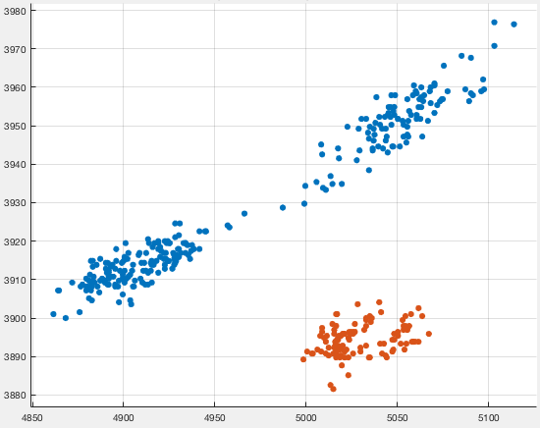
A Novel Approach to Classify and Detect Thoughts using Electroencephalography
Viraat Das
Senior at Morgantown High School, Morgantown WV
1. Introduction
3.1 Implementation (continued)
4.1 Music (continued)
4.2 Music (continued)
Electroencephalography (EEG) headsets, being highly portable, present a convenient, noninvasive method of recording the brain’s electrical activity. This project seeks to develop a method for the classification of thoughts, memories, and stimuli from EEG data, for potential use in brain-computer interface (BCI), and the treatment of Aphasia and disabilities that affect verbal communication. The two headsets used were the Emotiv EEG headset and OpenBCI containing 14 electrodes and 16 electrodes, manifesting data as 14 dimensional and 16 dimensional time series. For analysis of multidimensional data machine learning techniques were adopted to train models in the classification The model can classify events given new EEG data, and stochastic neighbor embedding allows visualization of the data in 2-D. Technology enabling nonverbal communication is exciting not only for its futurist appeal, but its potential to help millions suffering from Aphasia and other speech impairments. While methods such as MRI capture data with extreme resolution, EEG headsets would provide a noninvasive, inexpensive and accessible means of translating brain activity. This research aims to contribute to the future development of an EEG based BCI for therapeutic and rehabilitative purposes.
Accuracy of the Model with Markov Models
Accuracy
1. Introduction
Electroencephalography (EEG) headsets, being highly portable, present a convenient, noninvasive method of recording the brain’s electrical activity. I seek to develop a method for the classification of thoughts, memories, and stimuli from EEG data, for potential use in brain-computer interface (BCI), and the treatment of Aphasia and disabilities that affect verbal communication. The two headsets used were the Emotiv EEG headset and OpenBCI containing 14 electrodes and 16 electrodes respectively, manifesting data as 14-D and 16-D time series. For analysis of multidimensional data, I adopted support vector machines (SVM) and K-Nearest Neighbor learning algorithms to train models in the classification The model can classify events given new EEG data, and stochastic neighbor embedding allows visualization of the data in 2-D. Technology enabling nonverbal communication is exciting not only for its futurist appeal, but its potential to help millions suffering from Aphasia and other speech impairments. While methods such as MRI capture data with extreme resolution, EEG headsets would provide a noninvasive, inexpensive and accessible means of translating brain activity. This research aims to contribute to the future development of an EEG based BCI for therapeutic and rehabilitative purposes.
Subject 1
Autoregressive Coefficients
Vitebri Sets
Shows that music is processed relatively the same way among humans.
3.3 Frequency Processing
4.2 Pizza Toppings (Visual)
Inputs from Headset
Subject 2
Yule-Walker Equations
Collected data while subject viewed these toppings on the following pizza:
Anchovies (0)
Bacon (1)
Canadian Bacon (2)
Grilled Chicken (3)
Ground Beef (4)
Ham (5)
Italian Sausage (6)
Pepperoni (7)
Prosciutto (8)
Spicy Italian Sausage (9)
Emotiv Headset
OpenBCI
Based on desired data
configurations
2. Research Goals
The research consisted of three basic goals
If “thoughts” in the form of EEG Data can, in fact, be classified
A systematic way to predict the classification of new thoughts based on old data for a particular individual
Make sure the results were scalable with a high data and feature count size
Create a model that scales with each individuals data
Subject 3
Utilized PCA to explain up to 95% of the variance
Ham (5)
Italian Sausage (6)
Pepperoni (7)
Prosciutto (8)
Spicy Italian sausage (9)
Recursive calculation of the AR Parameters
Emotiv Headset
OpenBCI
 | Cubic KNN Model Accuracy | Prediction accuracy with trial 1 | Prediction accuracy with trial 2
Subject 1 | 100% | 96.4% | 95.3%
Subject 2 | 100% | 94.3% | 94.6%
Subject 3 | 99.7% | 94.1% | 93.7%
Both PCA and T-SNE would be valid. Due to low cost, PCA was chosen with an explained variance of 95%
2. Research Goals
3.1 Implementation
These values can be fed into classifiers
Quadratic SVM returned an accuracy rate of 94.1%
Model tested with second take showed an accuracy rate of 89.2%
The research consisted of three basic goals
If “thoughts” in the form of EEG Data can in fact be classified
A systematic way to predict the classification of new thoughts based on old data
Make sure the results were scalable with a high data and feature count size.
Figuring out the best set of algorithms to implement required having a visual sense of the data. Every electrode mapped out its own time series.
5. Future Works and Conclusion
Hidden Markov Model
Depending on data criteria, these models can be tuned for an individual
and used for thought classification in that context.
Ugly Duckling Theorem can be easily put in check with the methods
presented.
Possible usage: communicative device for patients suffering from Broca’s
Aphasia, neuroscience research, and expanded development of
endogenous and exogenous BCI.
3. Implementation
General electrode configuration of an EEG headset
Vitebri Algorithm Implementation
Figuring out the best set of algorithms to implement required having a visual sense of the data. Every electrode mapped out its own set of voltages.
4.1 Music (Auditory)
Five songs were analyzed
Overture by Pyotr Ilyich Tchaikovsky (0)
Asturias by Isaac Albeniz (1)
Op Op by Unknown (2)
The Sorceress Apprentice by Paul Dukas (3)
Suite española by Isaac Albeniz (4)
6. References
Visualizing 14-D and 16-D data required
Heyden, M. (2016). Classification of EEG data using machine learning techniques. LUP Student Papers. Retrieved December 4, 2017.
Hoefle, S., Engel, A., Basilio, R., Alluri, V., Toiviainen, P., Cagy, M., & Moll, J. (2018). Identifying musical pieces from fMRI data using encoding and decoding models. Scientific Reports, 8(1). doi:10.1038/s41598-018-20732-3
General electrode configuration of an EEG headset
Visualizing 14-D and 16-D data required
2) Calculated the covariance matrix using
a scaling factor of
3) The variance at most would be 95% to
ensure scalability of data while still
being able to explain the features
PCA returns a linear transformation for dimensionality reduction from the original matrix. T-SNE is non-linear and can capture trickier manifestations of the data, however it requires more computing power than PCA.
This confirmed that thoughts could indeed be classified and a thought prediction model could be created.
4.1 Dogs and Trees
Parallel Coordinate Plot – shows the variance in each electrode
Dogs
Trees
The clustering of the data shows that a
Linear SVM will work well
EEG data grouping from AF3 and F7 sensors
- dog
- tree

